Slide 1
Variable Selection Strategies 預測模型中變數篩選方式與技巧

Slide 2
大綱
變數篩選概念/重要性
變數縮減策略 (主觀：(臨床)背景知識)
變數篩選方法 (科學：統計/演算法)
Forward selection
Backward elimination
Stepwise selection
All possible subset selection
Stopping rules: p-values, AIC, BIC, Mallows’ C_{p} statistic
案例分享

Slide 3
Variable selection strategies and its importance in clinical prediction modelling
【論文導讀】
Chowdhury MZI, Turin TC. Fam Med Com Health 2020; 8:e000262.
doi:10.1136/fmch-2019-000262

Slide 4
The concept of variable selection
To determine a set of variables that will provide the best fit for the model so that accurate predictions can be made.
Variable selection should be more focused on clinical knowledge and previous literature than statistical selection methods alone.
Selection of appropriate variables should be undertaken carefully to avoid including noise variables in the final model.
Notes:
找出能最有效影響模型的因素，從而提高模型的預測準確度。
建議在選擇變數時，應該更注重臨床知識和先前的文獻，而不僅僅是依靠統計選擇方法。也就是說，除了依靠統計方法，還應該考慮到臨床專業知識和已有的研究成果。

Slide 5
Importance of variable selection
Improve the performance of models in terms of prediction
Deliver variables more quickly and cost-effectively by reducing training and utilization time
Facilitate data visualization and offer an overall better understanding of the underlying process that generated the data
Notes:
提高模型的預測性能
透過減少培訓和使用時間，更快、更經濟地交付變量
促進數據視覺化並提供對生成數據的底層過程的全面更好的理解。 比較容易理解生成資料的過程

Slide 6
The concept of variable selection
The principle of parsimony
Simple models are easier to interpret, generalize and use in practice.
One in ten rule
One variable can be considered in a model for every 10 events.
Overfitting
500 patients
40 patients die (events)
4 variables can be considered reliably
in the model to give a good fit
Generalizability
Model fit
Notes:
模型精簡原則: 用最少量的變數得到最大化的預測。
一個模型放太多變數，會讓模型太過依賴目前你看到的資料，不容易外推
十一法則: 每發生10個event / outcome 可能只能找出一個原因

Slide 7
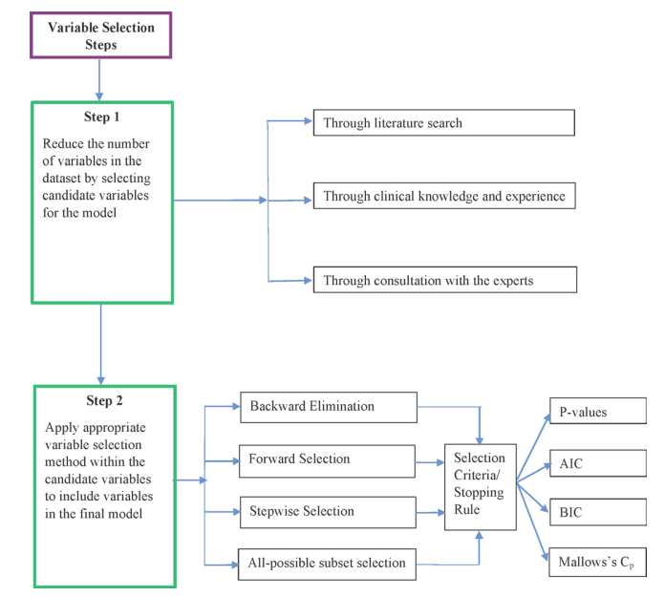
Overview

Slide 8
Variable reduction strategies
One way to restrict the list of potential variables is to choose the candidate variables first, particularly, if the sample is small.
Removing a correlated variable should not affect the performance of the model, as it measures the same underlying information as the variable to which it correlates.
Variables that have a large number of missing values can be excluded.
Often, 5–20 candidate variables are sufficient to build an adequate prediction model.
Peduzzi et al suggested 10–15 events per variable for logistics and survival models to produce reasonably stable estimates.
Notes:
常見的一些變數限縮策略：
限縮變數的一種方式就是先選擇候選變數，尤其是在樣本數少的時候
在研究開始之前，可以根據主題知識選擇特定主題的候選變數。

Slide 9
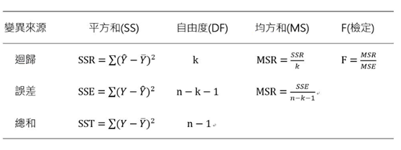
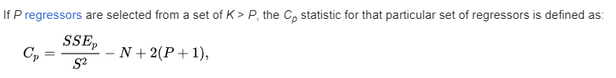
模型選擇與評估指標
F檢定(迴歸模型的顯著性檢定)：
H₀: 所有迴歸係數β=0
H₁: 其中一個以上迴歸係數β≠0
Mallows's Cp
The Cp statistic calculated on a sample of data estimates the sum squared prediction error (SSPE) as its population target.
A small Mallows’ Cp value near the number of variables indicates that the model is relatively more precise than other models (small variance and less bias)
Best subset model selection
殘差
MSE
Notes:
適用於linear regression analysis
用OLS (最小平方法估計)
https://en.wikipedia.org/wiki/Mallows%27s_Cp
K:所有變數 P:某部分的變數
Cp 越小越好
Mallows's Cp 是統計學中用來衡量線性回歸模型適合度的一種指標，特別用於模型選擇和變數篩選。這個指標是由統計學家 Colin Mallows 提出的，主要用來評估模型的預測能力和模型的複雜度之間的平衡。
Mallows's Cp 通常應用在多元線性回歸中，用來評估不同模型在給定資料集上的表現。
這個指標主要基於兩個關鍵的元素：模型的均方誤差 (Mean Squared Error, MSE) 和模型使用的變數數量。
S^2 原full model 的 MSE

Slide 10
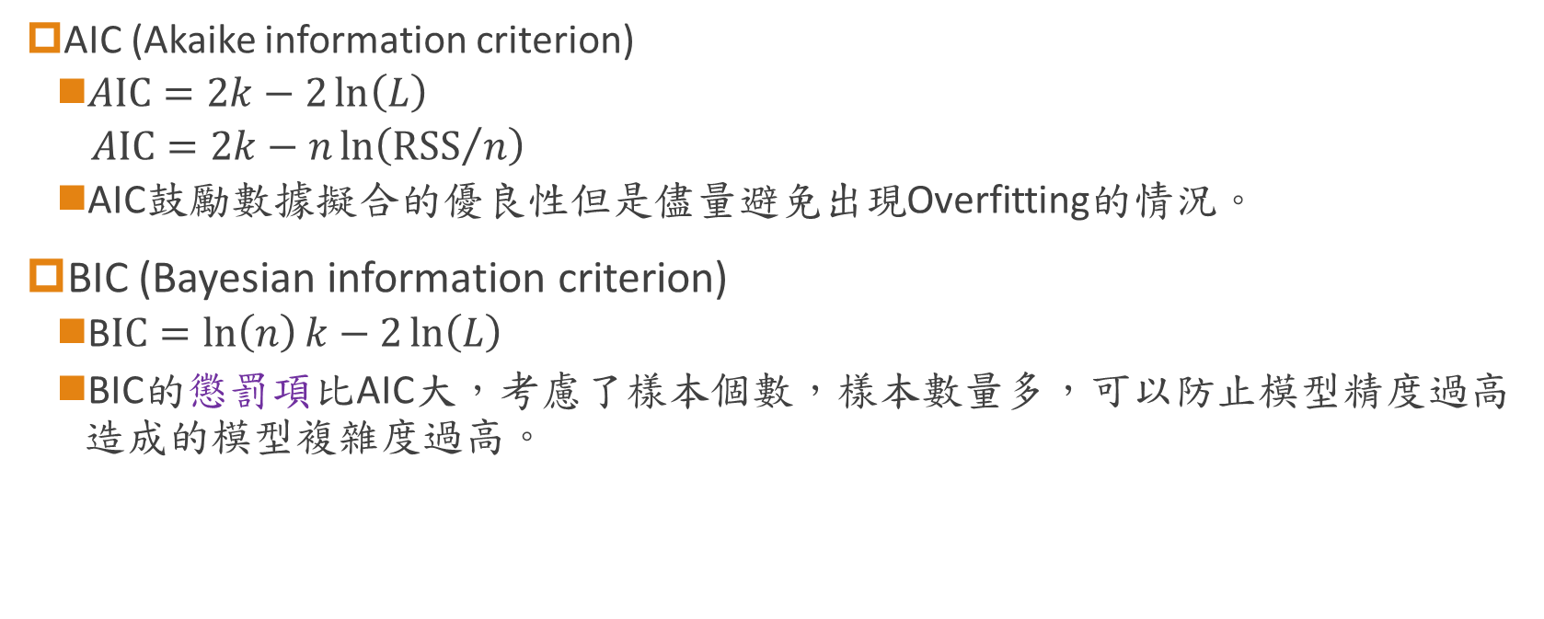
模型選擇與評估指標
AIC (Akaike information criterion)
$AIC=2k−2\ln\left(L\right)$
$$AIC=2k−n\ln\left({RSS}/n\right)$$
AIC鼓勵數據擬合的優良性但是儘量避免出現Overfitting的情況。
BIC (Bayesian information criterion)
B$IC=\ln\left(n\right)k−2\ln\left(L\right)$
BIC的懲罰項比AIC大，考慮了樣本個數，樣本數量多，可以防止模型精度過高造成的模型複雜度過高。
If our objective is to select a best model that will provide maximum predictive accuracy, then AIC is superior. However, if the goal is to select a correct model that is consistent, then BIC is superior.
Notes:
K 參數數量，L 概似函數, RSS為殘差平方和
AIC BIC 越小越好
2k=ln(n)k=2ln(L)
在模型中包含不同的變數提供了不同的模型，AIC嘗試透過平衡欠擬合和過度擬合來選擇模型。包含太少的變數通常無法捕捉真實的關係，而太多的變數會產生通用性問題。 因此，需要在模型擬合的簡單性和充分性之間進行權衡，AIC 可以幫助實現這一點。
If our objective is to select a best model that will provide maximum predictive accuracy, then AIC is superior
However, if the goal is to select a correct model that is consistent, then BIC is superior.

Slide 11
Variable selection methods
Full model approach:
Pros: the selection bias problem is absent and the SEs and p values of the variables are correct.
Cons: difficult in defining a full model.
Variables that show significance (p<0.25) in the univariate analysis, as well as those that are clinically important, should be included for multivariate analysis.
Statistical techniques:
Forward selection
Backward elimination
Stepwise selection
All possible subset selection
Stopping rule/ selection criteria:
P-values, AIC, BIC, Mallows’ Cp
Notes:
There is also a strong recommendation for using a p value in the range of 0.15–0.20

Slide 12
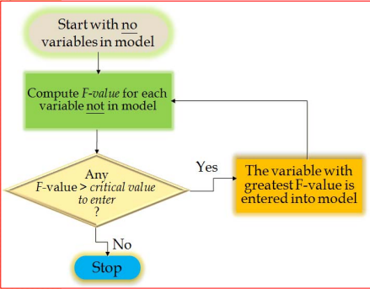
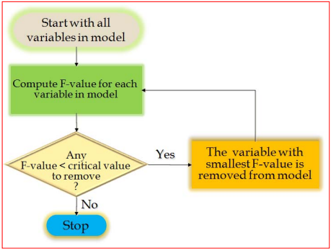
Forward selection (向前法) vs. Backward elimination (向後法)
Notes:
前向選擇，涉及從模型中沒有變數開始，使用選定的模型擬合標準測試每個變數的添加，添加其包含給出最統計上顯著的擬合改進的變數（如果有），並重複此過程，直到沒有一個能夠將模型改進到統計上顯著的程度。
向後消除，涉及從所有候選變數開始，使用選定的模型擬合標準測試每個變數的刪除，刪除其損失導致模型擬合在統計上最不顯著的惡化的變數（如果有），並重複此過程，直到沒有可以刪除更多變量，而不會造成統計上顯著的擬合損失。

Slide 13
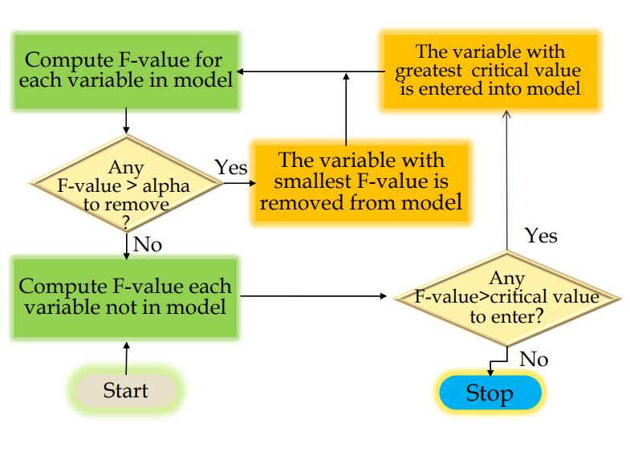
Stepwise selection (逐步迴歸法)
Example: Variables A, B, C, D, E, F, G
Round 1: (A) (B) (C) (D) (E) (F) (G) ---> enter C ➔➔ No remove --->
Round 2: (A|C) (B|C) (D|C) (E|C) F(|C) ---> BC ➔➔ (B|BC) (C|BC) No remove --->
Round 3: (A|BC) (D|BC) (E|BC) (F|BC) (G|BC) ----> BCF ➔➔ (CF|BCF) (BF|BCF) (BC|BCF) No remove --->
Round 4: (A|BCF) (D|BCF) (E|BCF) (G|BCF) -----> BCFG ➔➔ (CFG|BCFG) (BFG|BCFG) (BCG|BCFG) (BCF|BCFG) remove B CFG --->
Round 5: (A|CFG) (B|CFG) (D|CFG) (E|CFG) ---> CFG ➔ stop
P
Notes:
There is instability of variable selection if a different sample is used; however a large effective sample size (50 events per variable) can help overcome this issue.
The p values obtained by this method are also in doubt, as so many multiple tests occur during the selection process.
If there are too many candidate variables, then the method fails to provide the best model, as some irrelevant variables are entered into the model.
如果兩個變數高度相關且對結果的影響相等，但各自的顯著性低於其他不相關的變數，那麼在逐步選擇中有很大的可能性，這兩個相關變數都將被排除在模型之外。这是因为逐步選擇會基於個別變數的顯著性進行選擇，而不會考慮到它們之間的相關性。

Slide 14
All possible subset selection
Every possible combination of variables is checked to determine the best subset of variables for the prediction model.
If there are K variables, then there are 2^{k} possible models that can be built.
The disadvantage: computing can be an issue in an all subset selection procedure
Application of an all possible subset selection procedure was feasible here due to the small number of candidate variables.

Slide 15
Overview

Slide 16
案例分享
Case No: GF090723
題目：Predictive factors of excess body weight loss(EWL%) 1 year after the sleeve gastrectomy (SG) bariatric surgery in patients with Obesity
45 indep. vars.

Slide 17
案例分享
Case No: GF090723
分析流程：
Candidate variables
(B)
Age
BMI
SBP
Waist
Hip
Fat
Musculus
Education
DM
Sleep Apena
Glucose-AC
BUN
Creatinine
TG
HbA1C
Candidates full
Model AUC=0.722
All variables
K=45
Candidates backward
Model AUC=0.688
Univariate Analysis
(C)
Discussion
Stepwise
(pe=0.1, pr=0.05)
(A)
(D)
BMI
Creatinine
HbA1C
BMI
Creatinine, mg/dL
HbA1C, %
Stepwise
(pe=0.1, pr=0.05)
Model AUC=0.6992
Model AUC=0.6992
Notes:
variables of which p<0.05 in univariate analysis were put into the multiple logistic regression by backward model selection (pr=0.1), AUC=0.6941

Slide 18
Model Results
 | Model (B) |  | Model (C) |  | Model (A) (D)
 | aOR (95% CI) | p-value | aOR (95% CI) | p-value | aOR (95% CI) | p-value
Age, years | 0.97 (0.95, 1.00) | 0.021
BMI, kg/m² | 0.87 (0.79, 0.96) | 0.004 | 0.97 (0.95, 0.99) | 0.008 | 1.59 (0.93, 2.74) | 0.092
SBP, mmHg | 0.99 (0.98, 1.00) | 0.245 | 0.91 (0.88, 0.95) | <0.001
Waist, cm | 1.05 (1.01, 1.09) | 0.006
Hip, cm | 1.02 (0.98, 1.06) | 0.392
Fat, kg | 0.97 (0.93, 1.00+) | 0.079
Musculus, kg | 0.98 (0.95, 1.02) | 0.414
BMR | 1.25 (0.79, 2.00) | 0.337
Education (College and above vs others) | 1.25 (0.79, 2.00) | 0.337
Diabetes Mellitus | 1.28 (0.65, 2.54) | 0.479
Sleep Apnea ( Yes vs. No) | 0.76 (0.36, 1.58) | 0.455 | 0.99 (0.99, 1.00) | 0.009
Glucose-AC, mg/dL | 1.00 (0.99, 1.00+) | 0.180
BUN, mg/dL | 0.98 (0.91, 1.05) | 0.493
Creatinine, mg/dL | 0.53 (0.14, 1.98) | 0.345 |  |  | 0.32 (0.10, 0.97) | 0.045
TG, mg/dL | 1.00 (0.99+, 1.00+) | 0.146 | 0.99+ (0.99+,0.99+) | 0.045
HbA1C, % | 0.84 (0.62, 1.14) | 0.264 |  |  | 0.68 (0.56, 0.83) | <0.001
 | AUC= 0.722 |  | AUC=0.688 |  | AUC=0.699

Slide 19
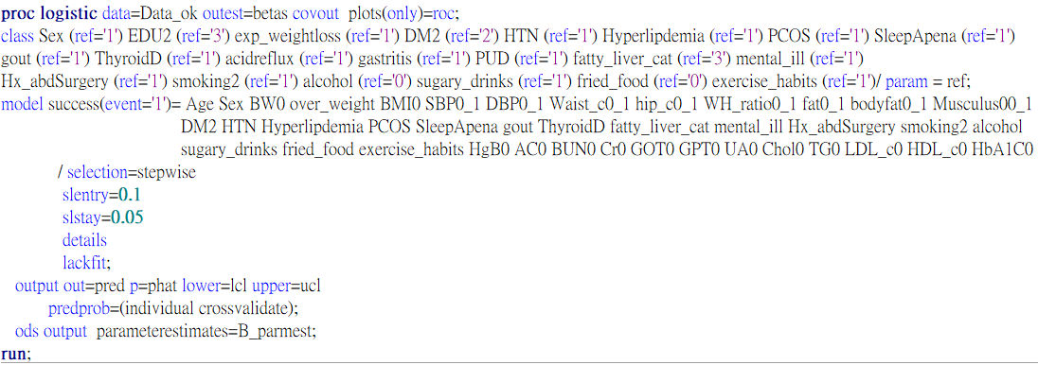

SAS code
Best subset
Notes:
The following statement requests the traditional stepwise method, where effects enter and leave based on significance levels, but with the following extra check: if any effect to be added or removed yields a model whose SBC statistic is greater than the SBC statistic of the current model, then the stepwise method terminates at the current model.
selection method=stepwise(select=SL stop=SBC) stophorizon=1;
In this case, the entry and stay significance levels still play a role because they determine whether an effect is deleted from or added to the model. This extra check might result in the selection terminating before a local minimum of the SBC criterion is found.
The following statement selects effects to enter or drop as in the previous example except that the significance level for entry is now 0.1 and the significance level to stay is 0.08. From the sequence of models produced, the selected model is chosen to yield the minimum AIC statistic:
selection method=stepwise(select=SL SLE=0.1 SLS=0.08 choose=AIC);

Slide 20
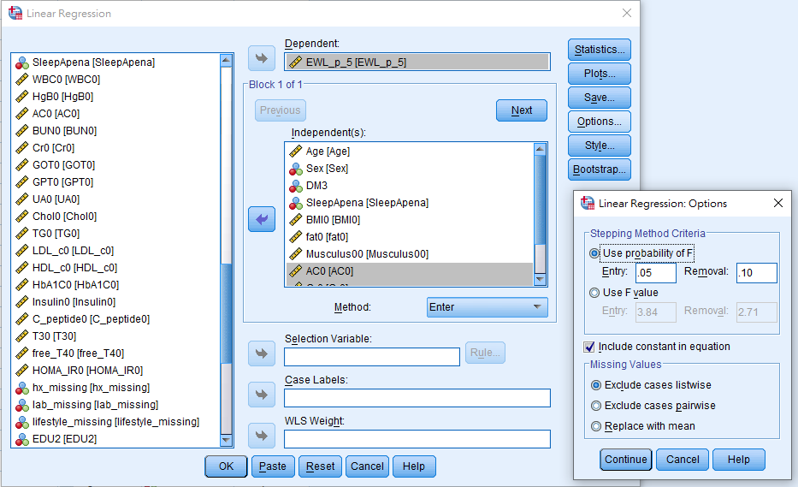
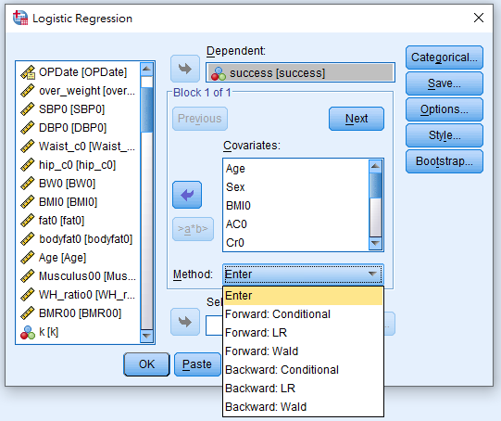
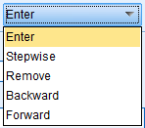
SPSS 操作介面
SPSS logistic/cox reg 只提供 Forward/Backward，無 stepwise
Linear regression 有 stepwise (categorical var. 需dummy)
Generalized linear model 沒有 model selection 功能
左: Linear regression 右: Logistic reg

Slide 21
案例分享
Variables | Statistics
Age (Yr) | 68.2 ± 7.4
Machine Type
A500 | 194 (14.0)
A800 | 1188 (86.0)
PSA (ng/dl) | 8.905 (6.51, 12.8)
PIRADS category#
2 | 14 (1.0)
3 | 271 (20.0)
4 | 553 (40.8)
5 | 516 (38.1)
Prostate volume (ml)# | 53.44 (40.25, 71.78)
MRI lesion size (mm) | 12 (8, 17)
Location- 1
(1) Rt | 652 (47.2)
(2) Lt | 645 (46.7)
Central/ Both (1+2) | 85 (6.2)
Location- 2
(1) Pz | 710 (51.4)
(2) Tz | 658 (47.6)
Both (1+2) | 14 (1.0)
Location- 3
(1) Upper gland | 194 (14.0)
(2) Middle gland | 737 (53.3)
(3) Lower gland | 426 (30.8)
Multiple locations (1+2/ 2+3/1+2+3) | 25 (1.8)
Case No: GF010924
論文主題：探討當攝護腺癌病患出現多病灶時，屬於必須優先做biopsy檢查的高風險病灶相較於低風險病灶的相關風險因子。
Outcome
Lesion Patho Dx
Benign | 574 (41.5)
Minor malignant (3+3) | 303 (21.9)
Major malignant (>3+3) | 505 (36.5)

Slide 22
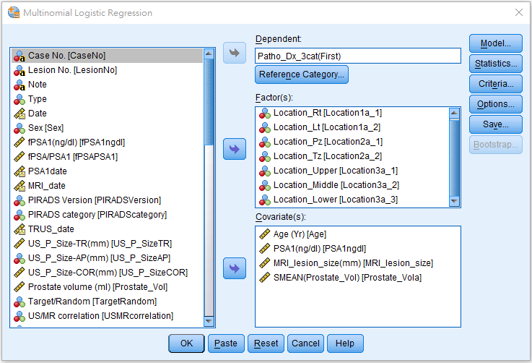
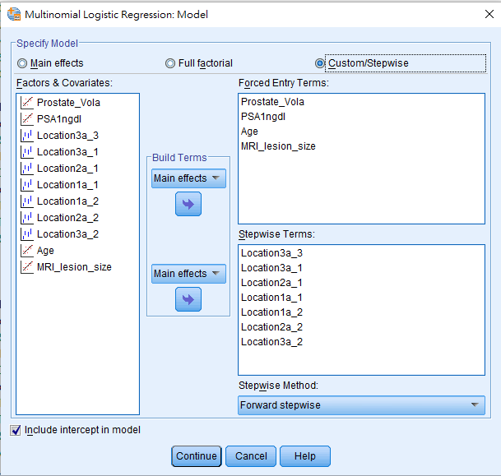
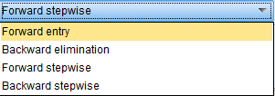
SPSS multinomial logistic Reg

Slide 23
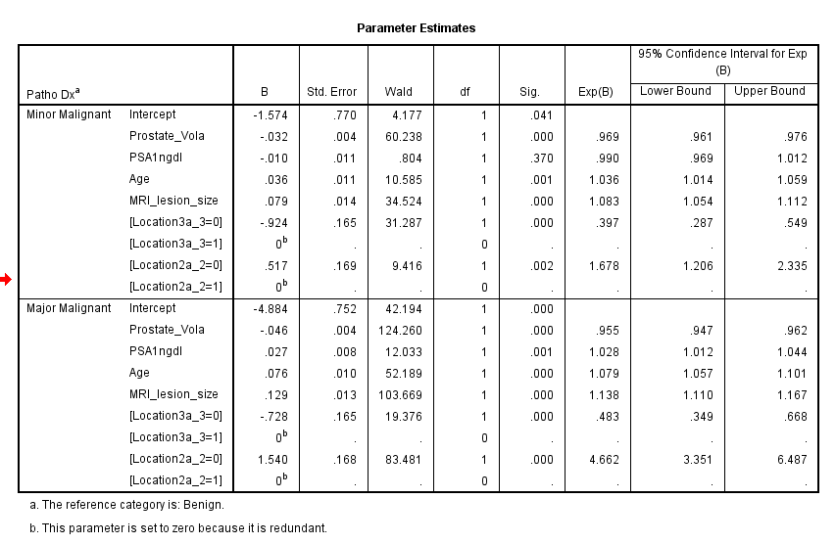
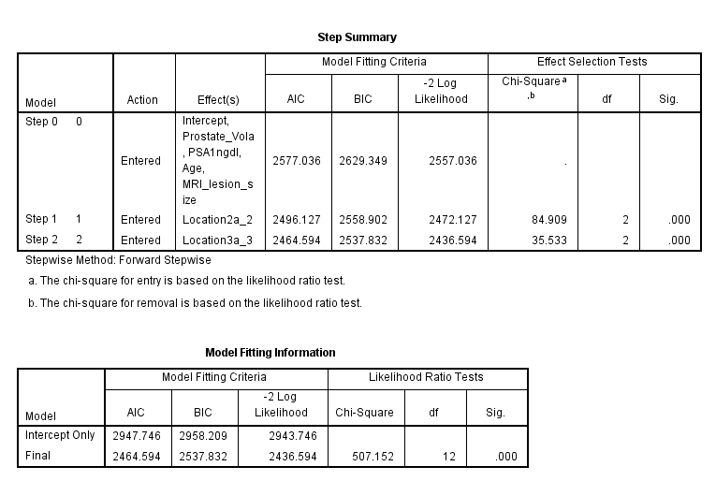
SPSS Output (multinomial logistic Reg)

Slide 24
R packages {olsrr} {MASS}
ols_step_all_possible(model) ols_step_best_subset(model) ols_step_forward_p(model) ols_step_backward_p(model)
fullModel = lm(X1 ~ ., data = dat) # model with all variables
nullModel = lm(X1 ~ 1, data = dat) # model with the intercept only
summary(stepAIC(nullModel, # start with a model containing no variables
direction = ‘forward‘, # run forward selection
scope = list(upper = fullModel, # the maximum to consider is a model with all variables
lower = nullModel), # the minimum to consider is a model with no variables
trace = 0)) # do not show the step-by-step process of model selection
Reference: (1) https://cran.r-project.org/web/packages/olsrr/vignettes/variable_selection.html
(2) https://quantifyinghealth.com/stepwise-regression-in-r/

Slide 25
Q & A
1. 模型的用處？
2. 多少樣本數可建立模型？
THE END…
Notes:
1.預測模型可以提供有關決定結果的變數、它們與結果的關聯強度的信息，並使用它們的特定值來預測結果的未來。

